Slide 1
Phishing Awareness Training
Presented BY : YUSRA SAMO

Slide 2
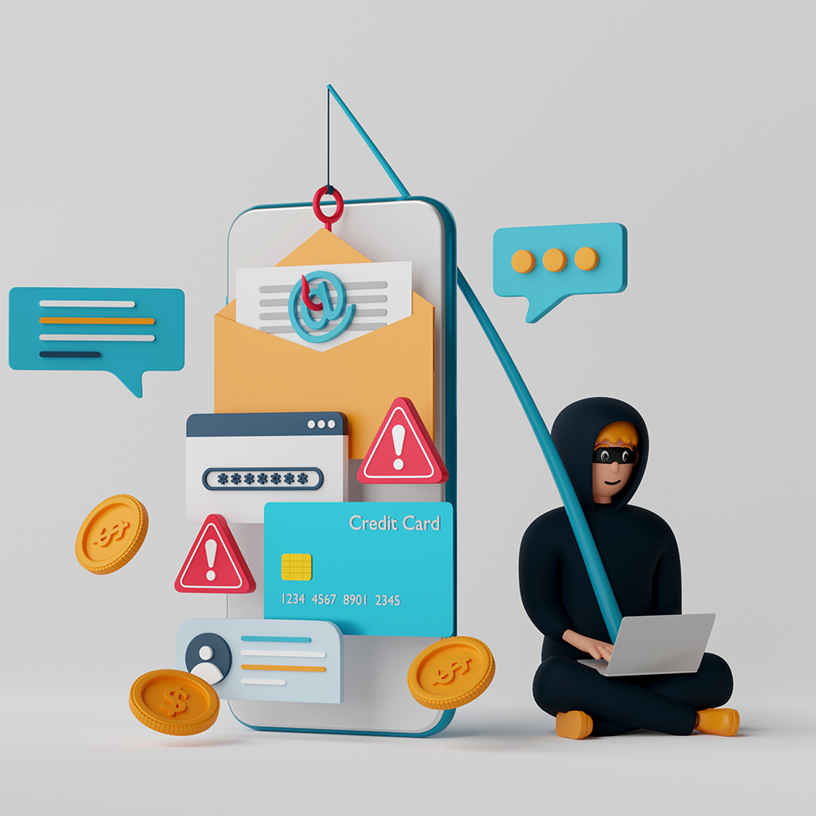
Introduction
Phishing attacks are social engineering strategies designed to steal sensitive user information by tricking individuals into engaging with malicious content. Understanding the various types and techniques of phishing is essential for effective protection.
Phishing can lead to severe consequences, including data breaches and financial loss, particularly in corporate and governmental settings. Recognizing its impact is crucial for maintaining security.

Slide 3

Explaination:

Slide 4
Phishing Techniques:
There are several common types of phishing, including email phishing, spear phishing, and whaling, each targeting different victims with varying techniques. Awareness of these types helps in prevention.
Phishing techniques involve spoofing email addresses and creating fake websites that appear trustworthy, making it difficult for victims to identify the threat. Vigilance is key in avoiding these traps.

Slide 5
Email phishing

Slide 6
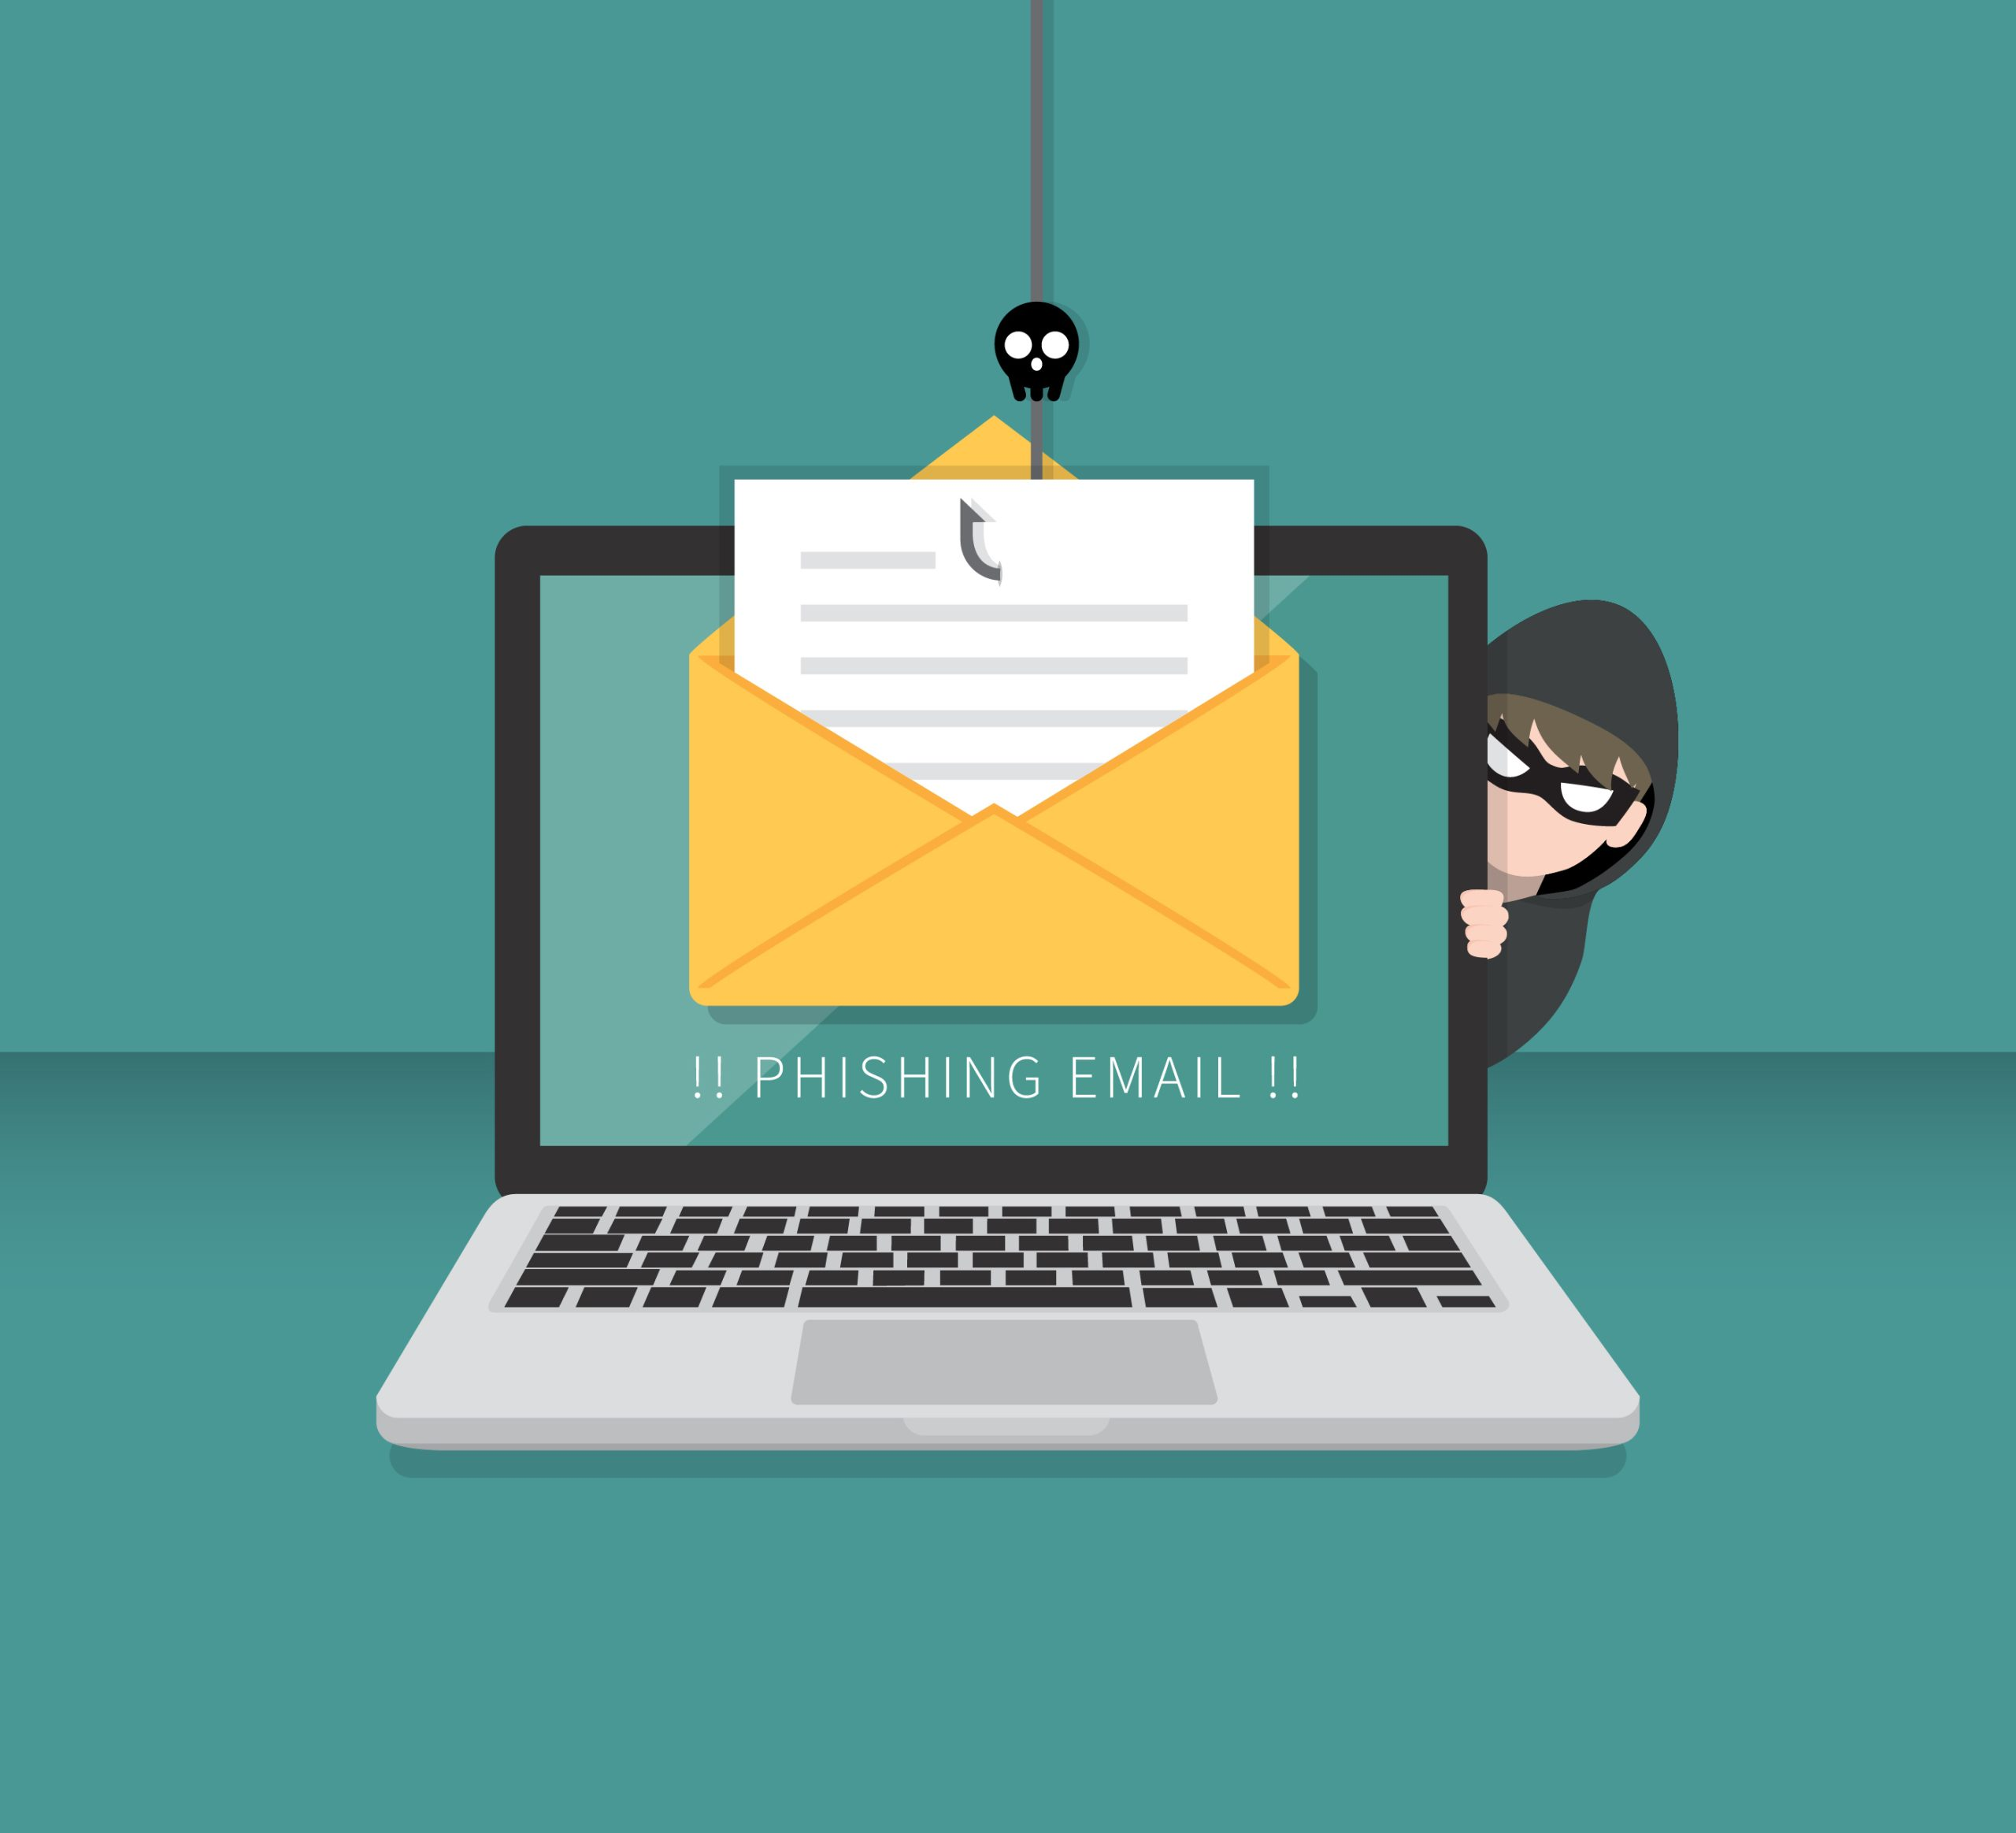
Email phishing:
Email phishing is a type of online scam in which attackers pretend to be a trusted source in emails to trick people into giving away sensitive information, like usernames, passwords, or bank details.
These phishing emails usually look like they come from reputable organizations—such as banks or popular online services—and often contain urgent messages that encourage recipients to click on harmful links or download dangerous attachments.
Clicking on these links may lead to fake websites that look real, where users are misled into entering their personal information.
Phishing attacks aim to steal this information for financial gain, identity theft, or unauthorized access to accounts. As phishing remains a common cybersecurity threat, individuals must stay alert and cautious with their email interactions.

Slide 7
Spear Phishing:

Slide 8
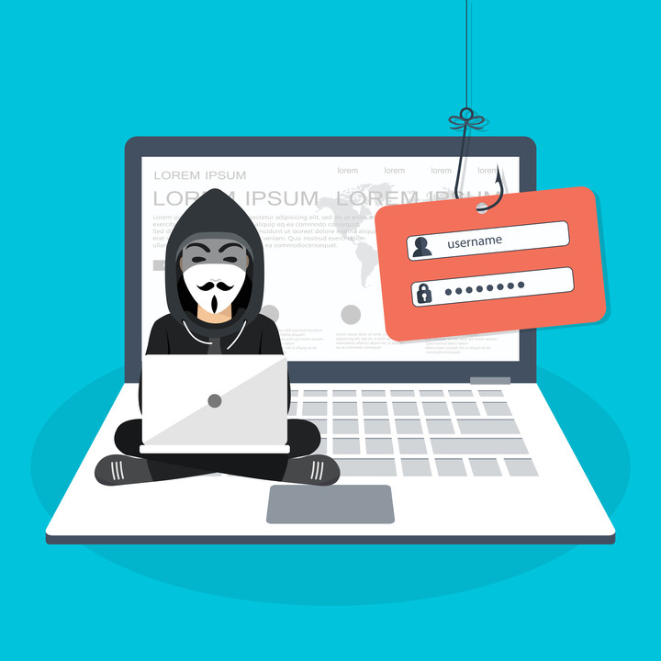
Spear Phishing:
Spear phishing is a targeted type of phishing where attackers send deceptive emails aimed at a specific person or organization, making them seem more believable.
Unlike regular phishing, which reaches a wide audience, spear phishing involves detailed research to find personal information about the victim, such as their name, job role, and connections.
Attackers often impersonate someone familiar, like a coworker or business partner, to craft a convincing message.
Their goal is to trick the recipient into revealing sensitive information, such as passwords or financial details, or to install harmful software on their devices.
Due to its personalized approach, spear phishing is often more successful than typical phishing attacks and poses a significant risk to both individuals and organizations.

Slide 9
Whaling phishing

Slide 10
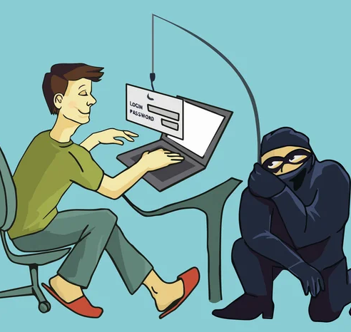
Whaling phishing:
Whaling attacks target high-profile individuals like CEOs by tricking them into revealing sensitive information through highly customized phishing tactics. These scams exploit personal communication methods, making them hard to detect. Whaling, a type of spear phishing, specifically targets high-value individuals in organizations, leveraging their authority and often insecure communication methods. This increases their vulnerability to attacks. The attackers often gather information over time to create convincing emails that appear to be from trusted sources, increasing the likelihood of success for their scams. Personalized content in whaling attacks includes the target's name and job title, making detection difficult. This sophisticated approach enhances the effectiveness of the phishing attempts.

Slide 11
How to Prevent Whaling?

Slide 12
How to Prevent Whaling?
Educating employees about whaling attacks is crucial for identifying phishing emails and increasing overall awareness of potential threats. This knowledge empowers individuals to recognize suspicious activities.
Establishing a multi-step verification process for sensitive data requests can enhance security by providing an additional layer of protection against unauthorized access. This helps ensure that only legitimate requests are processed.
Implementing robust security measures is crucial to combat phishing attacks. This includes frequent backups, password management, and utilizing multi-factor authentication for enhanced protection.
Strict password management policies are essential for organizations. Employees should regularly change passwords and avoid reusing them across multiple applications to strengthen security.
Technical measures like spam filters can help prevent phishing emails from reaching users. Organizations should adopt a variety of approaches to safeguard sensitive information.

Slide 13
How to Prevent Phishing?

Slide 14
How to Prevent Phishing?
Phishing attacks can manipulate users into providing sensitive information through deceptive emails or messages. Recognizing these scams is crucial for protecting personal and organizational data.
Email authentication can significantly enhance security by verifying the legitimacy of senders. This helps users identify fraudulent communications more effectively.
Users should be cautious of emails requiring urgent personal information, especially when prompted by unfamiliar sources. Verifying the sender is essential to avoid falling victim to scams.
Training and education on phishing awareness are vital for end users. This knowledge equips individuals to recognize and respond to potential phishing attempts appropriately.

Slide 15
thankyou

